Slide 1
Traffic Sign Detection Using DL & Model Comparison

Slide 2
Group Members
Talukder Abdullah Al Talha 1813193642
Shadman Sakib 1813190642
Md. Sharukh Fardin 1821463042

Slide 3
Problem Statement & How Did We Come Up With The Idea
Problem Statement :
On average 3700 people are dying around the world in road accidents every day.
1.35 million are dying in a year.
Reasons:
Not seeing the traffic signs properly due to bad daylight or bad weather.
Not recognizing the traffic signs.
Some drivers may have bad eyesight.

Slide 4
Aim of our project :
To build a system which will help drivers or AI to recognize the traffic signs even in bad daylight.
To help the drivers who have bad eyesight.
To develop our project for the automated cars in future.
We will use three different models and compare their accuracy. The models we plan to use are YOLOv5 , SSD and Faster RCNN.
How Did We Come Up With This Idea?
-When thinking about automated cars and traffic management throughout the world, we thought why not implement something similar in our project.

Slide 5
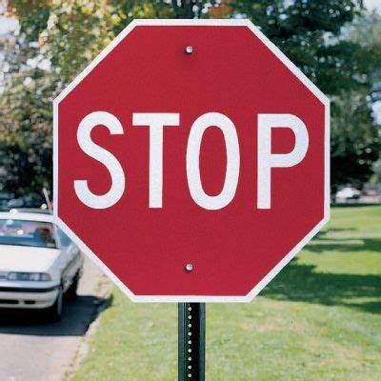
Related Works
Traffic Sign Recognition and Classification Using YOLOv2, Faster RCNN and SSD
Used YOLOv2, Faster RCNN and SSD
Used Tensorflow 2 and for dataset they used ‘German Traffic sign dataset’.
Also used traditional evaluation parameters such as mAp, FPS.
The accuracy of YOLOv2 is better than Faster RCNN and SSD by 3.5% and 21% respectively.
YOLOv2 was 3 times quicker than Faster RCNN with a better accuracy.[1]

Slide 6
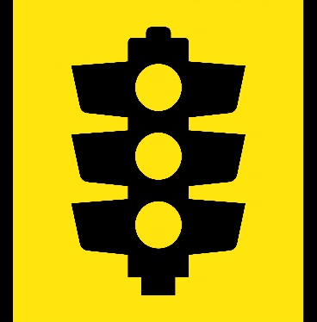
Related Works (Continues)
Real‑Time Detection and Recognition of Railway Traffic Signals Using Deep Learning
Used YOLOv5 for recognition and
detection
Used FRsign dataset
Images in Dataset: 100,000 Pictures.[2]
Iraqi Traffic Signs Detection Based On YOLOv5
Used YOLOv5.
Used the Iraqi Traffic Sign
Detection Benchmark (IQTSDB)
dataset.
High efficiency in different conditions
such as sunny, cloudy, weak light and
rainy conditions.
Also efficient in detecting traffic signs
different sizes.
Mean Average Precision (mAP) was compared
to YOLOv2, and YOLOv3. [3]

Slide 7

Related Works (Continues)
Traffic Signs Detection Based on Faster R-CNN
Used Faster R-CNN.
Not need to extract image features
mAp value was 0.3449. [4]

Slide 8
Working Plan
After collecting the dataset, we will be following these six steps:
Step 1: Processing the dataset.
Step 2: Building three proper models ( YOLOv5, Faster RCNN, SSD)
Step 3: Training & testing the models.
Step 4: Improving the accuracy of each model.
Step 5: Implementing our project.
Step 6: Comparing the accuracy of our models.

Slide 9

References
[1] Garg, P., Chowdhury, D. R., & More, V. N. (2019, July). Traffic sign recognition and classification using YOLOv2, faster RCNN and SSD. In 2019 10th International Conference on Computing, Communication and Networking Technologies (ICCCNT) (pp. 1-5). IEEE.
[2] Staino, A., Suwalka, A., Mitra, P., & Basu, B. (2022). Real-Time Detection and Recognition of Railway Traffic Signals Using Deep Learning. Journal of Big Data Analytics in Transportation, 4(1), 57-71.
[3] Aggar, A., & Zaiter, M. (2021, July). Iraqi Traffic Signs Detection Based On Yolov5. In 2021 International Conference on Advanced Computer Applications (ACA) (pp. 5-9). IEEE.
[4] Z. Zuo, K. Yu, Q. Zhou, X. Wang and T. Li, "Traffic Signs Detection Based on Faster R-CNN," 2017 IEEE 37th International Conference on Distributed Computing Systems Workshops (ICDCSW), 2017, pp. 286-288, doi: 10.1109/ICDCSW.2017.34.

Slide 10

THANK YOU

